Slide 1
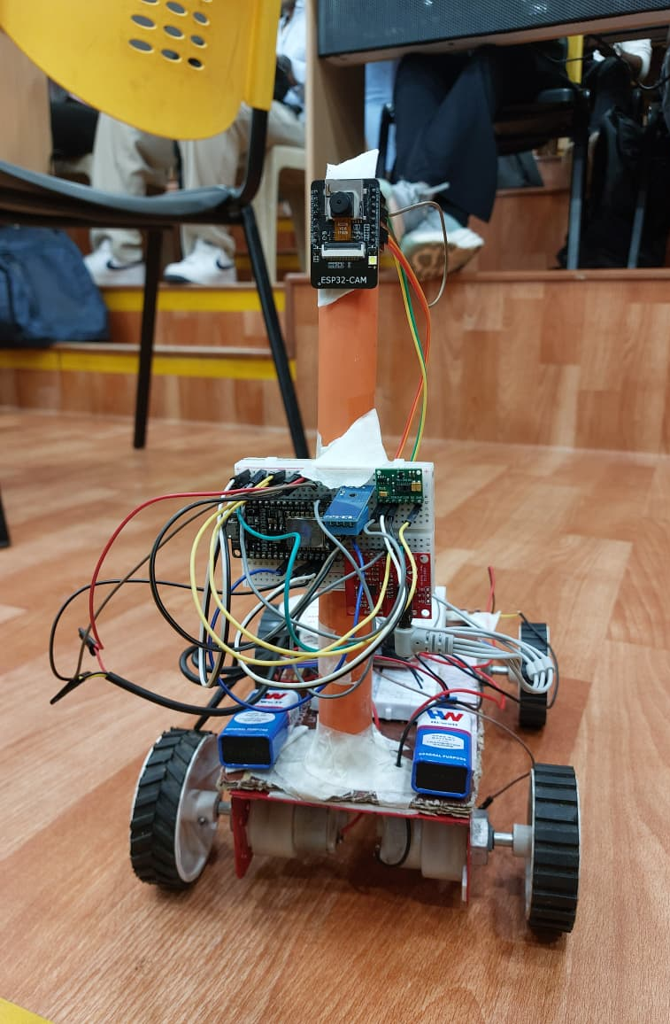
AI Powered Health Assistant for remote patient supervision
InnovAct 2025 Hackathon
IoT Track
Team: VitalEyes | Yukti ID: IR2025-996023
Ayush Jaiswal - 23BEC0204
Saunok Roy - 23BEC0255
Avanthika Hegde- 23BCB0069
Aarush Lenka - 23BEC0325

Slide 2
What are the issues we are trying to address?
In overcrowded hospitals, rural areas, or disaster zones, patients often lack timely medical attention and continuous monitoring.
1
2
3
Limited Physical Presence
Incomplete Monitoring
Accessibility Gap
Traditional systems overlook the critical emotional and mental states, focusing only on physical vitals.
A significant need exists for a low-cost, mobile, and intelligent system that can autonomously reach and monitor patients.
Doctors and caregivers cannot always be physically present for continuous patient oversight.

Slide 3
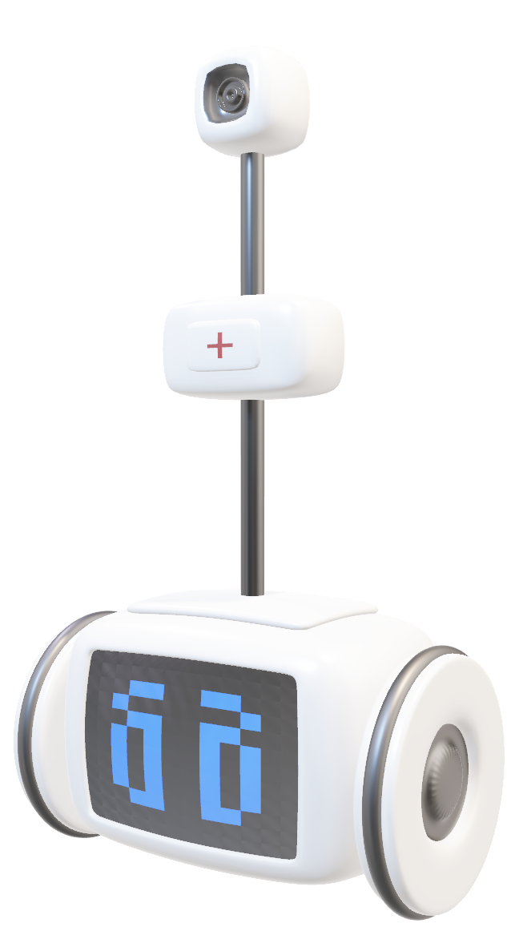
Introducing the Health Assistance Rover
Our solution is a compact, autonomous rover designed to revolutionize patient monitoring. Equipped with advanced biosensors and an AI-powered camera, it provides comprehensive health insights, ensuring no patient is overlooked.
Biosensor Integration
Monitors heart rate, SpO2, temperature, and ECG with precision.
Emotional Analysis
Mounted camera uses AI to detect and interpret patient emotional states.
Web Dashboard Access
Real-time data visualization for patients and doctors, accessible anywhere.
AI-Driven Insights
Analyzes vital trends and provides proactive recommendations for care.

Slide 4








Our Technical Blueprint
Hardware Components
Software & Platforms
Rover Mobility & Control
AWS IoT Core
Motor driver & ESP32 for robust navigation.
Secure device connectivity
Blynk IoT
Vital Sign Acquisition
Rover control dashboard.
MAX30100 (SpO2/HR), DHT11 (Temp), Body Temp Sensor for comprehensive data.
React.js & Express.js
Dynamic web dashboard for user interface.
Visual & Auxiliary
Supabase
ESP32-CAM for emotional analysis, AD3282 for ECG, and breadboard for prototyping.
Flexible PostgreSQL database for patient data.
DeepFace 0.0.95
Facial recognition & emotion analysis.
Langchain
Large Language Model integration for insights.
FastAPI
High-performance API for ML/LLM services.
n8n
Workflow automation for alerts & actions.

Slide 5
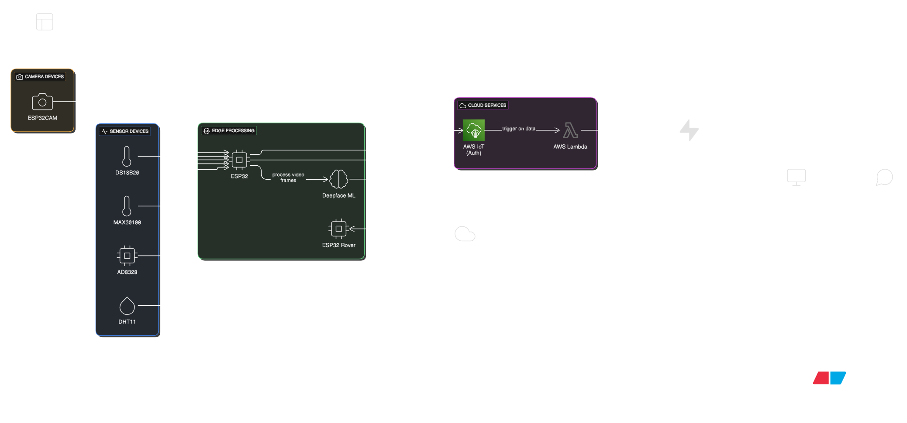
Architecture Diagram

Slide 6
Prototype in Action
Our working prototype demonstrates the seamless integration of hardware and software, bringing autonomous patient monitoring to life.
Autonomous Navigation
Real-time Data Capture
AI-Powered Emotion Detection
Intuitive Web Interface
The rover adeptly navigates diverse indoor environments, reaching patients when and where needed.
Sensors provide immediate, accurate readings of vitals, updated constantly on the dashboard.
The dashboard presents complex data simply, enabling quick insights for caregivers.
The camera accurately identifies emotional states, providing crucial psychological context.

Slide 7
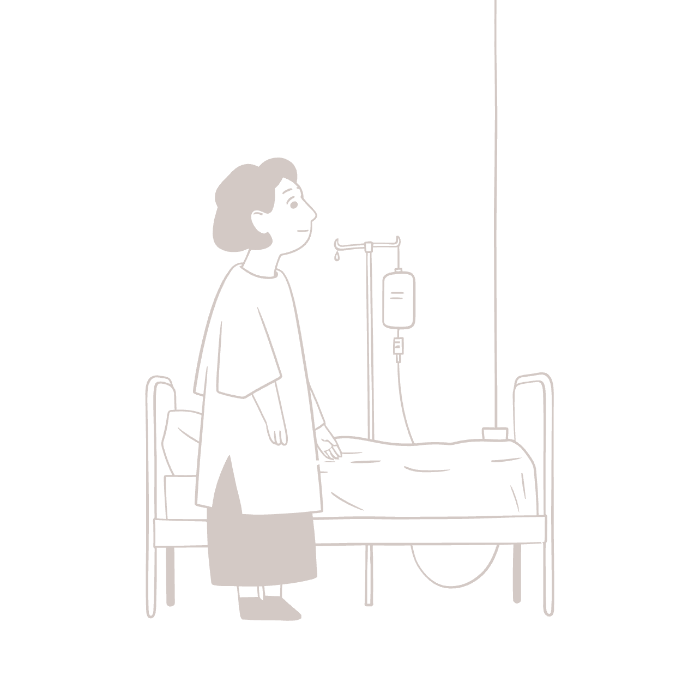
Transformative Impact & Broad Applications
Our project addresses the surging demand for remote healthcare, elderly care, and disaster response. It's a low-cost, mobile, and intelligent solution poised to redefine patient monitoring.
Patient Outcomes
Improves care quality through continuous, comprehensive monitoring.
Caregiver Support
Reduces workload by providing autonomous assistance and real-time alerts.
Accessibility
Extends care to remote areas and overcrowded facilities.

Slide 8

What hurdles did we overcome?
Sensor Integration Complexity
Data Security
Emotional AI Accuracy
Ensuring safe low-latency data transmission from the rover to the cloud and dashboard was crucial for live monitoring.
Achieving reliable emotion detection from a mobile camera, especially in varied lighting conditions, was a key hurdle.
Integrating diverse biosensors (ECG, SpO2, Temperature) for accurate, simultaneous data presented significant hardware challenges.
Solution: Optimized data protocols and efficient cloud infrastructure (AWS IoT Core) for minimal delay.
Solution: Extensive training with diverse datasets and fine-tuning DeepFace models for robust performance.
Solution: Implementation of interrupts to remove interference of I2C sensors

Slide 9

What does the Future hold?
1
Implementation of rPPG model
2
Usage of Industry-level Sensors
Remote Photoplethysmography model can be used for detecting blood pressure using OpenCV
It will help us get more fine-tuned and accurate values from the sensors
3
Autonomous Navigation
Implementing obstacle and object detection to allow the bot to move automatically and tend to patients without human intervention

Slide 10




Conclusion
Our solution is designed for continuous evolution, with clear pathways for enhancement and expansion:
Remote Patient Health Supervision
Secure Data Transmission
Doctors can access patient vitals remotely
Usage of AWS IoT to deal with safety issues
Enhanced Mobility & Navigation
AI Insights
Rover movement control from Blynk IoT web dashboard
AI powered emotion detection and recommendations based on analysis of health parameters

Slide 11
Acknowledgements
We extend our deepest gratitude to those who supported our journey.
Our Dedicated Team
Ayush Jaiswal (Hardware Engineer) - 23BEC0204
Saunok Roy (Fullstack Dev) - 23BEC0255
Avanthika Hegde(ML Engineer) - 23BCB0069
Aarush Lenka (Design & Automation) - 23BEC0325

